Slide 1

HLabs style guide
Updated September 2018

Slide 2
Infinity Framework

Slide 3
Infinity Framework Color Palette
Quadrant | Official IF Colors | Unofficial (lighter) | Unofficial (darker)
IF upper left (PE&E) | #628fa2 58, 107, 140 | #b7ccd5 183, 204, 213 | #2e454e 46, 69, 78
IF upper right (Competencies) | #f1ef4c 241, 239, 76 | #fbfaca 251, 250, 202 | #a8a60d 168, 166, 13
IF lower right (Agility) | #78c5c6 120, 197, 198 | #d8eeee 216, 238, 238 | #367f80 54, 127, 128
IF lower left (CF&I) | #4fb24f 79, 178, 79 | #aedbae 174, 219, 174 | #255425 37, 84, 37
Lighter/darker shades created using www.0to255.com. New colors are eight shades lighter/darker than original color.

Slide 4

Infinity Framework Logo
^{Leadership Capabilities}
^{The Leader Today}
^{Pivotal Experience}
^{& Expertise}
^{The Leader’s Past}
^{Agility} ^{& Potential}
^{The Leader’s Future}
^{Culture Fit} ^{& Impact}
^{The Leader’s Shadow}

Slide 5





More Infinity Framework Logos

Slide 6


Still More Infinity Framework Logos
More IF logos here:
https://heidrick.app.box.com/s/kknewlwgt5wgi1v98gz14rfm0bonumih/folder/26018011803

Slide 7
Leadership Signature

Slide 8


LS report graphics

Slide 9

















LS Report Icons – Styles, Success Drivers, Exec Summary Categories
Collaborator
Composer
Energizer
Forecaster
Harmonizer
Pilot
Producer
Provider
Agility / Innovation / Growth
Appreciation / Recognition
Collaboration
Customer and Quality Focus
Direction / Purpose
Performance Orientation
Positive Spirit / Vitality
How They Lead
Leadership Styles
How They Think
Starting Points
How They Succeed
Success Drivers
Culture Implications

Slide 10
Leadership Signature report color palette/sample chart
RGB | Hex
79, 178, 79 | #4fb24f
51, 141, 51 | #338d33
18, 166, 46 | #12a62e
100, 199, 100 | #64c764
151, 217, 151 | #97d997
34, 213, 25 | #22d519
0, 238, 74 | #00ee4a
106, 211, 53 | #6ad335
146, 229, 35 | #92e523
89, 89, 89 | #595959
106, 175, 107 | #6AAF6B

Slide 11
LAQ

Slide 12
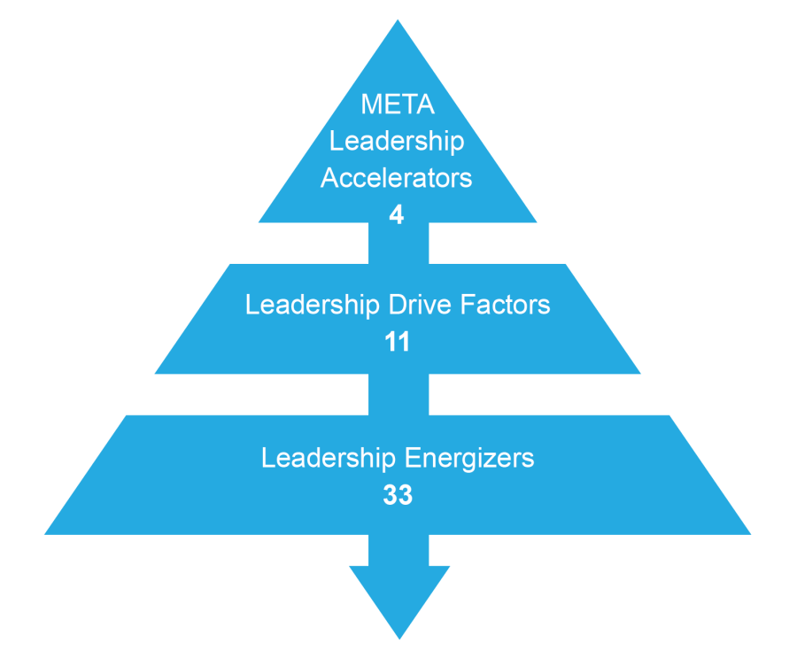
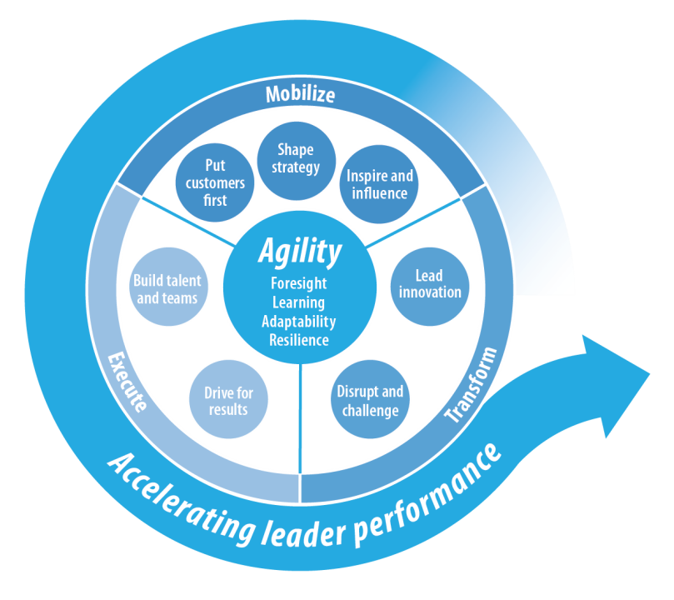
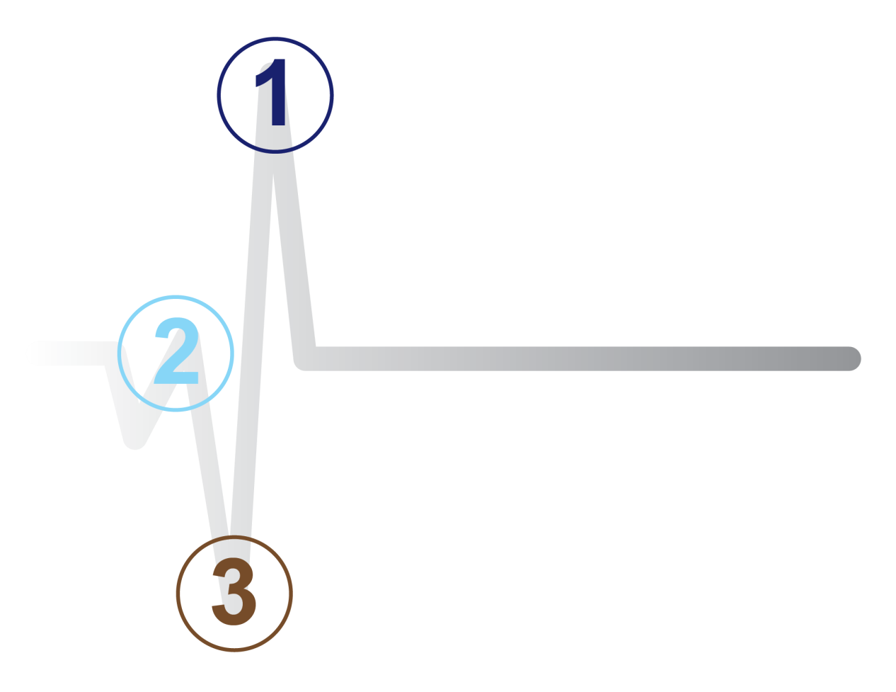

LAQ Report Graphics
Derailing
Lagging
Steady
Advancing
Accelerating

Slide 13




LAQ Logos

Slide 14
LAQ colors – extracted from report output
Color | RGB | Hex
 | 24, 40, 113 | #182871
 | 0, 176, 222 | #00b0de
 | 40, 170, 225 | #28aae1
 | 103, 194, 235 | #67c2eb
 | 156, 220, 249 | #9cdcf9
 | 215, 239, 253 | #d7effd

Slide 15
PowerBI Color Palettes

Slide 16
1.0 Color Palette
Color Usage
Color is used to communicate effectively, call attention to details or outliers and generally make reports easier to understand and use. Common colors also help brand reports and create a consistent look and feel across reports that have been developed by multiple power users. Below are suggested colors for report design.
Primary Colors
Use these colors for the majority of site elements – headers, charts, and graphs.
Light Blue
Black
Grey
Turquoise
Grey
R: 43
G: 167
B: 219
Hex: #2BA7DB
R: 0
G: 0
B: 0
Hex: #000000
R: 98
G: 143
B: 162
Hex: #628FA2
R: 117
G: 162
B: 151
Hex: #75A297
R: 68
G: 89
B: 104
Hex: #445968
Color Scales
These colors are used to communicate scale-specific messaging.
Black and White
Use these colors for text and backgrounds, and other report elements as needed.
Orange (Bad)
Grey (Neutral)
Blue (Good)
Black
White
R: 255
G: 165
B: 0
Hex: #FFA500
R: 179
G: 179
B: 179
Hex: #B3B3B3
R: 68
G: 114
B: 196
Hex: #4472C4
R: 0
G: 0
B: 0
Hex: #000000
R: 255
G: 255
B: 255
Hex: #FFFFFF

Slide 17
1.1 Regional Colors
Color Usage
Colors listed below should be consistently across reports when Region is differentiated in a visual utilizing color
Asia Pacific
Europe
Americas
R: 98
G: 143
B: 162
Hex: #628FA2
R: 117
G: 162
B: 151
Hex: #75A297
R: 68
G: 89
B: 104
Hex: #445968
**** It is recommended that the colors are set as they are listed above. However, due to noted functionality gap in Power BI, Data Colors may change after closing and reopening PBIX file.

Slide 18
1.2 Practice Colors
Color Usage
Colors listed below should be consistently across reports when Practice is differentiated in a visual utilizing color
Consumer Markets
Healthcare + Life Sciences
Education, Non-Profit + Social Enterprise
R: 98
G: 143
B: 162
Hex: #628FA2
R: 117
G: 162
B: 151
Hex: #75A297
R: 68
G: 89
B: 104
Hex: #445968
Industrial
Financial
Global Technology + Services
R: 43
G: 167
B: 219
Hex: #2BA7DB
R: 253
G: 98
B: 94
Hex: #FD625E
R: 242
G: 200
B: 15
Hex: #F2C80F
**** It is recommended that the colors are set as they are listed above. However, due to noted functionality gap in Power BI, Data Colors may change after closing and reopening PBIX file.

Slide 19
1.3 Function Practice Colors
Color Usage
Colors listed below should be consistently across reports when Function Practice is differentiated in a visual utilizing color
Marketing, Sales + Strategy
CEO + BOD
Information + Technology Officers
Legal, Risk, Compliance + Government Affairs
R: 98
G: 143
B: 162
Hex: #628FA2
R: 117
G: 162
B: 151
Hex: #75A297
R: 68
G: 89
B: 104
Hex: #445968
R: 166
G: 105
B: 153
Hex: #A66999
Supply Chain Management
Financial Officers
Human Resource Officers
Research & Development
R: 43
G: 167
B: 219
Hex: #2BA7DB
R: 253
G: 98
B: 94
Hex: #FD625E
R: 242
G: 200
B: 15
Hex: #F2C80F
R: 138
G: 212
B: 235
Hex: #8AD4EB
**** It is recommended that the colors are set as they are listed above. However, due to noted functionality gap in Power BI, Data Colors may change after closing and reopening PBIX file.

Slide 20
Other Tools, Surveys, etc.

Slide 21
















Various Logos

Slide 22
HC / Leadership Accelerator Graphics
Acceleration
LEADER ACCELERATOR
TEAM ACCELERATOR
ORGANIZATION ACCELERATOR

Slide 23
Heidrick Consulting Palette and Font Styles
SLIDE TITLE
Font: Arial Narrow, All Caps, Bold
Size: 37 pt.
Color: Black (R: 0, G: 0, B: 0)
Kerning: Normal
SLIDE SUB-HEADING
Font: Arial, All Caps
Size: 12 pt.
Color: Gray (R: 166, G: 166, B: 166)
Kerning: Loose
CONTENT HEADERS/ MAIN POINTS
Font: Arial Narrow, All Caps, Bold
Size: 14-18 pt.
Color: Choose from color palette
Shown Here: Light Blue (R: 43, G: 131, B: 163)
Kerning: Normal
Descriptive text
Font: Arial, Sentence Case
Size: 12-14 pt.
Color: Black (R: 0, G: 0, B: 0) or White (R: 255, G: 255, B: 255)
Kerning: Normal
WHITE
R: 255, G: 255, B: 255
Hex: ffffff
BLUE GRAY
R: 56, G: 101, B: 121
Hex: 386579
BLACK
R: 0, G: 0, B: 0
Hex: 000000
LIGHT BLUE
R: 43, G: 131, B: 163
Hex: 2b83a3
DARK GRAY
R: 56, G: 46, B: 46
Hex: 382e2e
DARK BLUE
R: 0, G: 72, B: 131
Hex: 004883
GREEN
R: 52, G: 86, B: 73
Hex: 345649
INDIGO
R: 72, G: 81, B: 115
Hex: 485173
ORANGE
R: 195, G: 79, B: 59
Hex: c34f3b
PURPLE
R: 119, G: 72, B: 115
Hex: 774873

Slide 24
BoardAI
#0280B2
R: 2 G: 128 B: 178

Slide 25
The Heidrick Way color scheme
#ededed
#c44f3b
#386679
#004883
#312030
#2b84a4
#acb2cb

